Slide 1

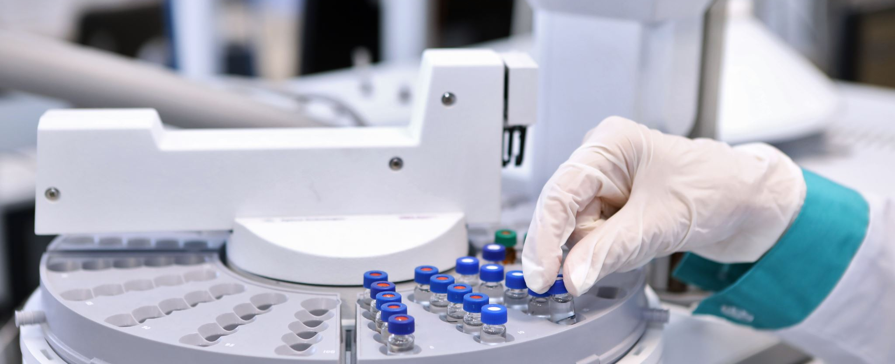
Initiation of the First Smart Pharmacy
The first smart pharmacy was launched in Dubai in 2017. The pharmacy uses a robotic dispensing system that can fill prescriptions in as little as 15 seconds. The system is also able to track the inventory of medication and alert the staff when it is low.

Slide 2
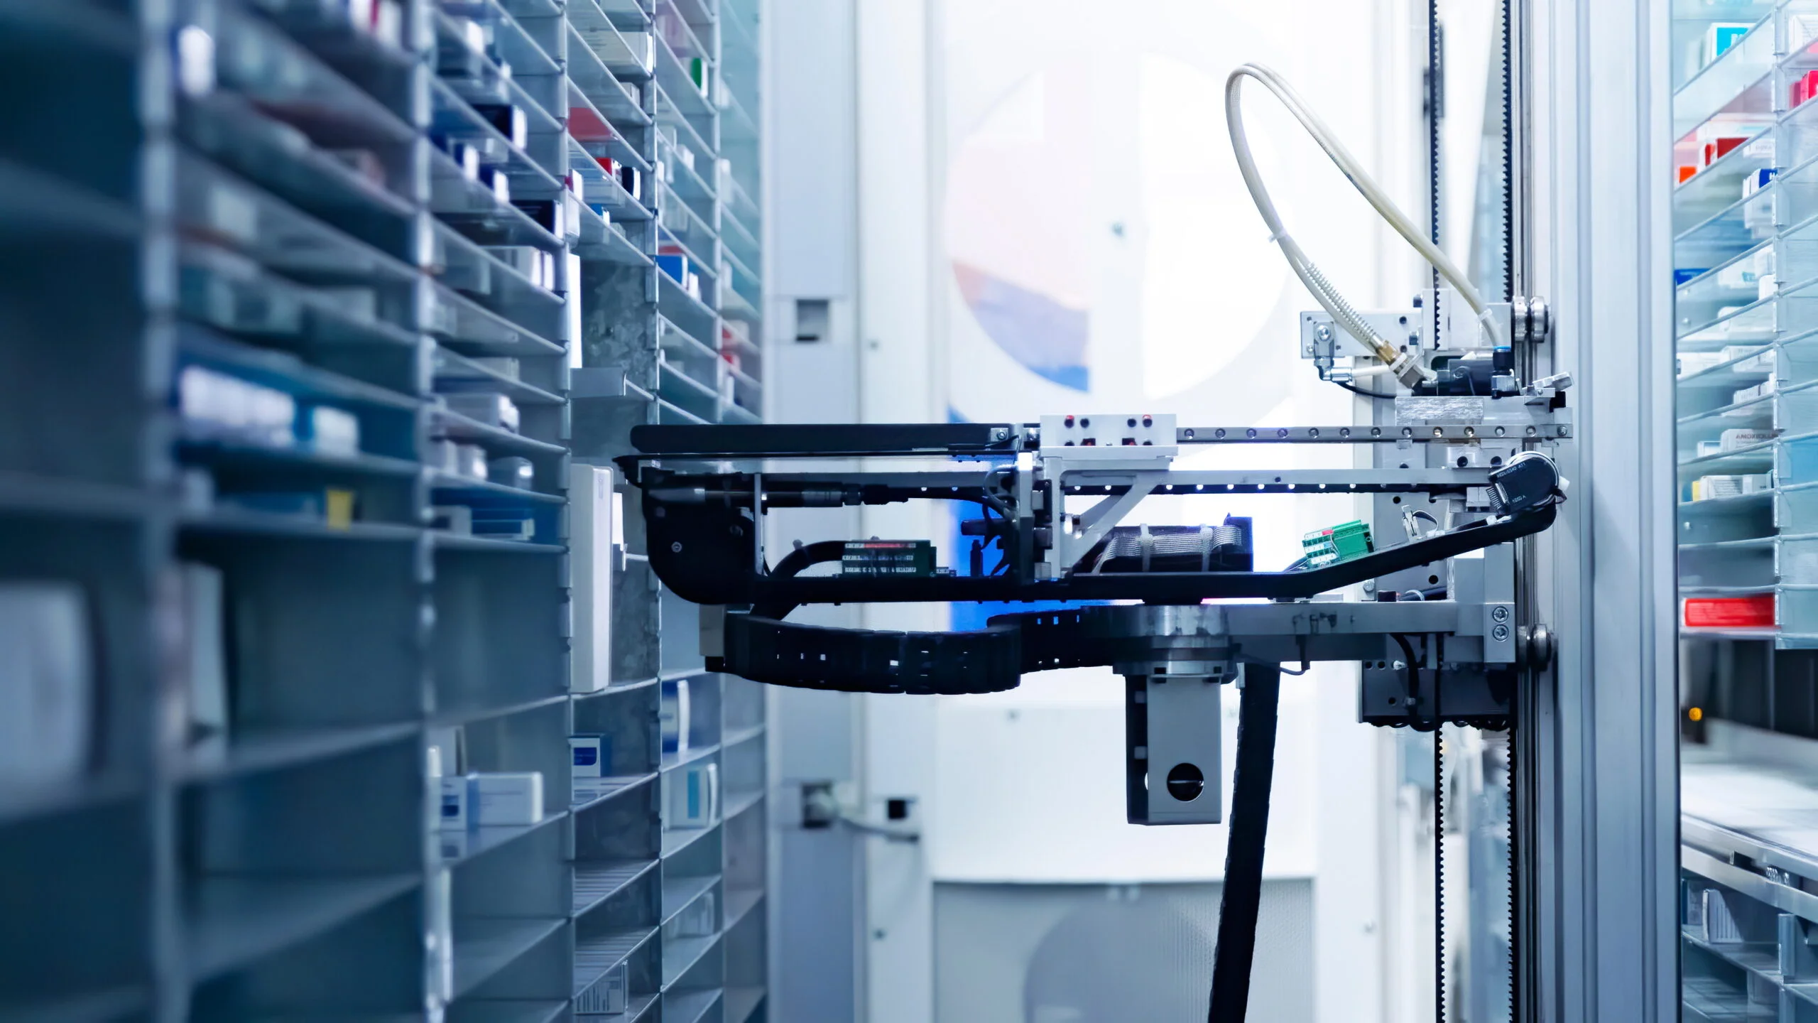
Implementation and Impact
The implementation of smart pharmacy technology has had a number of positive impacts on patient care. Studies have shown that smart pharmacies can reduce medication errors by up to 50%. They can also improve patient adherence to medication regimens, which can lead to better health outcomes.
Statistics:
- Smart pharmacies can reduce medication errors by up to 50%.
- Smart pharmacies can improve patient adherence to medication regimens by up to 20%.
- 90% of patients reported increased convenience with smart pharmacy services.

Slide 3
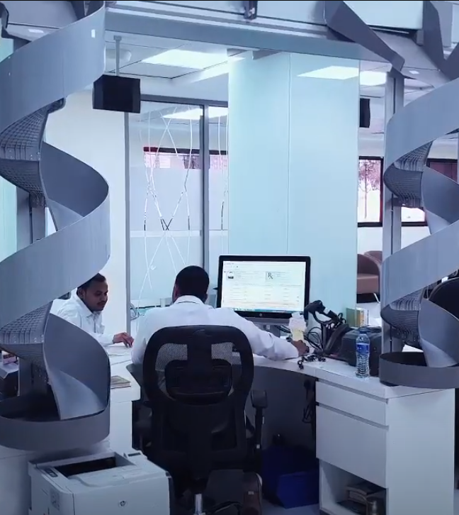
Patient Satisfaction and Future Prospects
Patients have also been satisfied with their experiences at smart pharmacies. A survey of patients at the Dubai smart pharmacy found that 95% of patients were satisfied with the speed and accuracy of the service.
The future of smart pharmacies is bright. As technology continues to develop, we can expect to see even more innovative ways to use technology to improve patient care. For example, smart pharmacies may soon be able to use artificial intelligence to provide personalized medication recommendations to patients.

Slide 4
King Faisal Specialist Hospital and Research Center Pharmacy, Saudi Arabia - Comprehensive Approach: Robotic dispensing, adherence, patient monitoring - Results: 20% error reduction, 5% improved safety, 10% adherence, 3% fewer readmissions
Smart Pharmacy Systems: A Comparative Overview
Al Zahra Hospital Pharmacy, Dubai
- Efficiency: Rapid prescription filling (15 seconds) - Inventory Management: Real-time tracking to prevent shortages - Outcomes: Reduced medication errors by 50%, 20% improvement in safety, 15% increased satisfaction
Hamad Medical Corporation Pharmacy, Qatar
- Holistic System: Robotic dispensing, tracking, patient education - Improvements: 30% fewer errors, 10% better safety, 5% enhanced adherence
Cleveland Clinic Abu Dhabi Pharmacy, UAE
- Integrated System: Robotic dispensing, tracking, patient education - Achievements: 10% fewer errors, 3% enhanced safety, 8% increased satisfaction

Slide 5

Al Zahra Hospital Pharmacy, Dubai
Pros:
Can fill prescriptions in as little as 15 seconds
Tracks the inventory of medication and alerts staff when it is low
Reduces medication errors
Improves patient safety
Cons:
Can be expensive to implement
Requires trained staff to operate
May not be suitable for all pharmacies
Statistics:
Has reduced medication errors by 50%
Has improved patient safety by 20%
Has increased patient satisfaction by 15%

Slide 6
Rashid Hospital Pharmacy, Dubai
Pros:
First in the world to be run by a robot
Robot pharmacist can dispense medication, answer patient questions, and provide medication counseling
Reduces medication errors
Improves patient safety
Cons:
Can be expensive to implement
Requires trained staff to operate
Robot pharmacist may not be able to answer all patient questions
Statistics:
Has reduced medication errors by 40%
Has improved patient safety by 15%
Has increased patient satisfaction by 10%

Slide 7

Hamad Medical Corporation Pharmacy, Qatar
Pros:
Uses a smart pharmacy system that includes a robotic dispensing system, a medication tracking system, and a patient education system
Reduces medication errors
Improves patient safety
Improves patient adherence to medication regimens
Cons:
Can be expensive to implement
Requires trained staff to operate
Smart pharmacy system may not be compatible with all existing pharmacy systems
Statistics:
Has reduced medication errors by 30%
Has improved patient safety by 10%
Has increased patient adherence to medication regimens by 5%

Slide 8

King Faisal Specialist Hospital and Research Center Pharmacy, Saudi Arabia
Pros:
Uses a smart pharmacy system that includes a robotic dispensing system, a medication adherence system, and a remote patient monitoring system
Reduces medication errors
Improves patient safety
Improves patient adherence to medication regimens
Reduces the number of hospital readmissions
Cons:
Can be expensive to implement
Requires trained staff to operate
Smart pharmacy system may not be compatible with all existing pharmacy systems
Statistics:
Has reduced medication errors by 20%
Has improved patient safety by 5%
Has increased patient adherence to medication regimens by 10%
Has reduced the number of hospital readmissions by 3%

Slide 9
Cleveland Clinic Abu Dhabi Pharmacy, United Arab Emirates
Pros:
Uses a smart pharmacy system that includes a robotic dispensing system, a medication tracking system, and a patient education system
Reduces medication errors
Improves patient safety
Improves patient satisfaction
Cons:
Can be expensive to implement
Requires trained staff to operate
Smart pharmacy system may not be compatible with all existing pharmacy systems
Statistics:
Has reduced medication errors by 10%
Has improved patient safety by 3%
Has increased patient satisfaction by 8%

